Slide 1
Writing
Advanced Formulas
in Microsoft Flow
Ted Pattison Power platform MVP

Slide 2
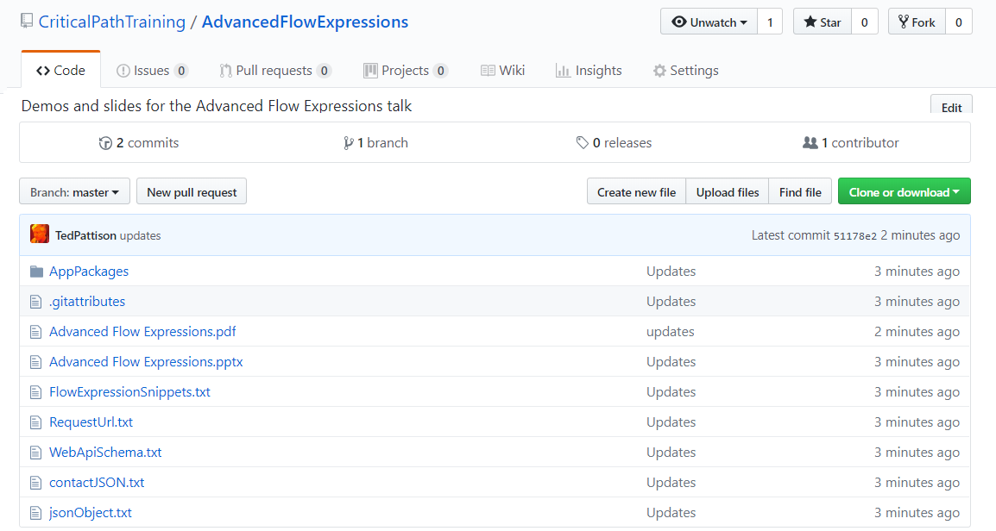
GitHub Repo
All slides and demo files available for download
https://github.com/CriticalPathTraining/AdvancedFlowExpressions

Slide 3
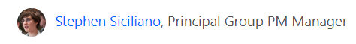
Agenda
Flow Fundamentals
Writing Flow Expressions
Control of Flow
Processing Data and Preparing Content
Converting Between Types
Advanced Techniques
Thanks for coming up with the idea for this session

Slide 4

Deep Dive into PowerApps and Flow
Two action-packed days of building PowerApps and Flows
Getting Started with PowerApps Studio
Designing PowerApps using Advanced Techniques
Building PowerApps for SharePoint Online
Introduction to Microsoft Flow
Designing Flows to Automate an Approval Process
Building PowerApps and Flows for Power BI
Working with the Common Data Service for Apps
Managing Application Lifecycle with PowerApps and Flow
More info
https://www.criticalpathtraining.com
info@criticalpathtraining.com

Slide 5
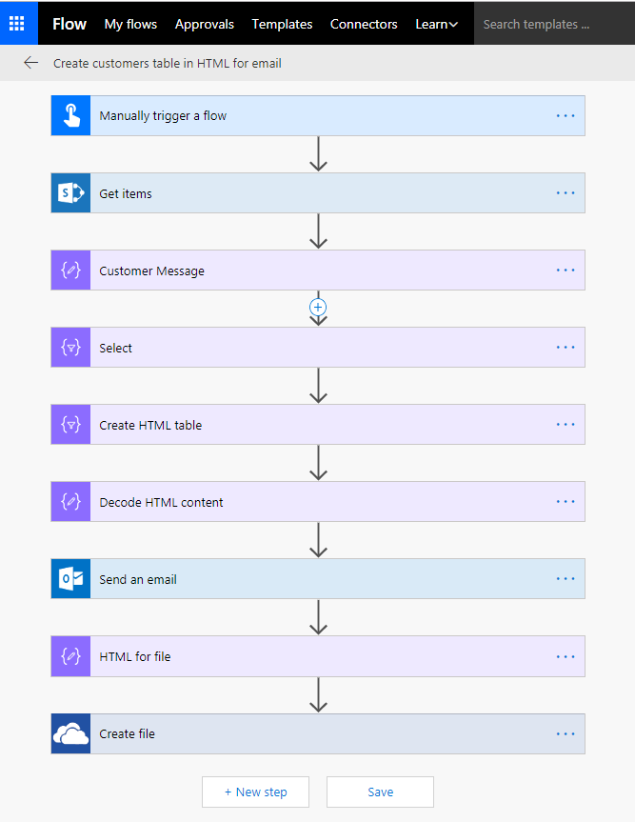
Building Blocks of Flow
Triggers - events that start a flow
Actions - tasks and operation executed by flow
Services - sources and destinations for data
Connectors - wrappers to communicate with service APIs
Custom Web API
SharePoint List
HTTP
Connector
SharePoint
Connector

Slide 6
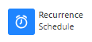
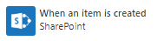
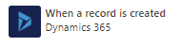
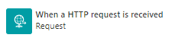
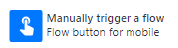
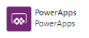
Flow Trigger Types
Scheduled Flow Triggers
Runs periodically based on an interval
Automated Flow Triggers
Runs when something happens
On-demand Flow Triggers
Runs when a user clicks a button

Slide 7
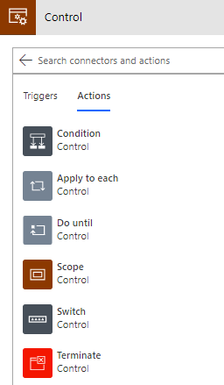
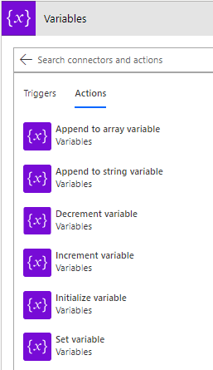
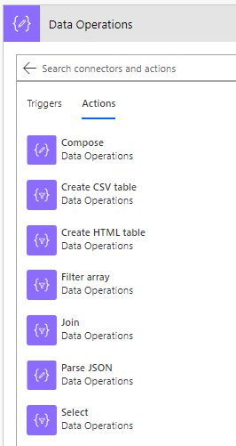
Core Action Categories
Control: actions to provide control-of-flow
Variables: actions to manage state within flow lifetime
Data operations: action to process data & prepare content

Slide 8
Data Automatically Flows from Step to Step
Data in flows added by step outputs
Data added in step output is available in later steps
It's easy to configure step input data using output data in previous steps
Certain outputs displayed/hidden based on types of input and output
Flow
Trigger
Outputs:
File Name
File Size
File Content
Action 1
Inputs:
File Name
File Size
File Content
Outputs:
Title
Count
Action 2
Inputs:
File Name
File Size
File Content
Title
Count

Slide 9
Demo 1 Changing the Flow Trigger Type

Slide 10
Agenda
Flow Fundamentals
Writing Flow Expressions
Control of Flow
Processing Data and Preparing Content
Converting Between Types
Advanced Techniques

Slide 11
Writing Flow Expressions
Scenarios for writing Flow expressions
Perform string manipulation
Generate a GUID or a random number
Convert types
Perform simple inline calculations
Handling optional values
Writing conditional statements using "If" statements
Working with arrays

Slide 12
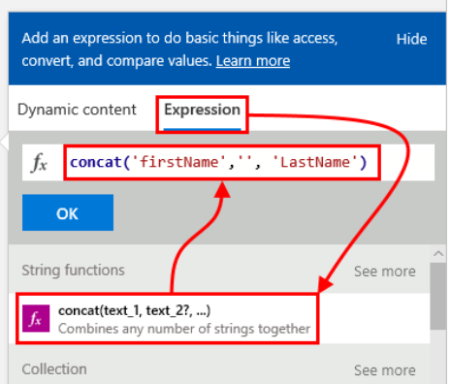
Writing Expressions
Expressions written in fx textbox
Click OK to enter expressions

Slide 13
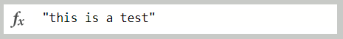
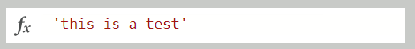
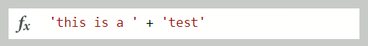
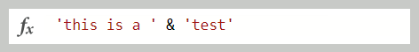
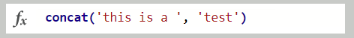
Workflow Definition Language (WDL)
Flow expressions written in Workflow Definition Language
Same language used in Azure Logic Apps
WDL is more powerful yet more complicated than PowerApps
WDL does not overload operators like PowerApps does
WDL requires single quotes instead of double quotes
Invalid: no double quotes
Valid
Invalid : + operator not supported
Invalid : & operator not supported
Valid

Slide 14
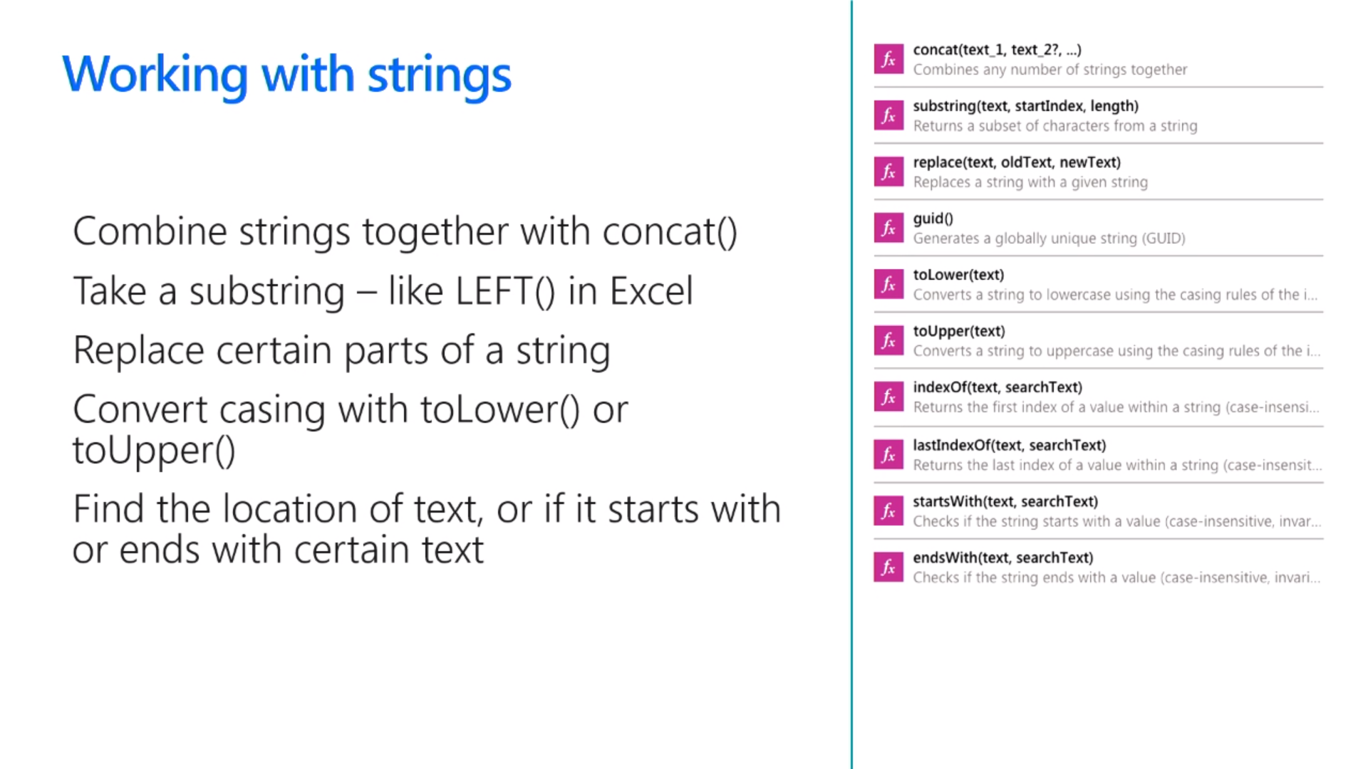
Working with Strings
Parse text together using concat()
Parse out text using substring()
Convert casing using toLower() and toUpper()
Search string using indexOf and startsWith()
Create new GUID identifier using guid()

Slide 15
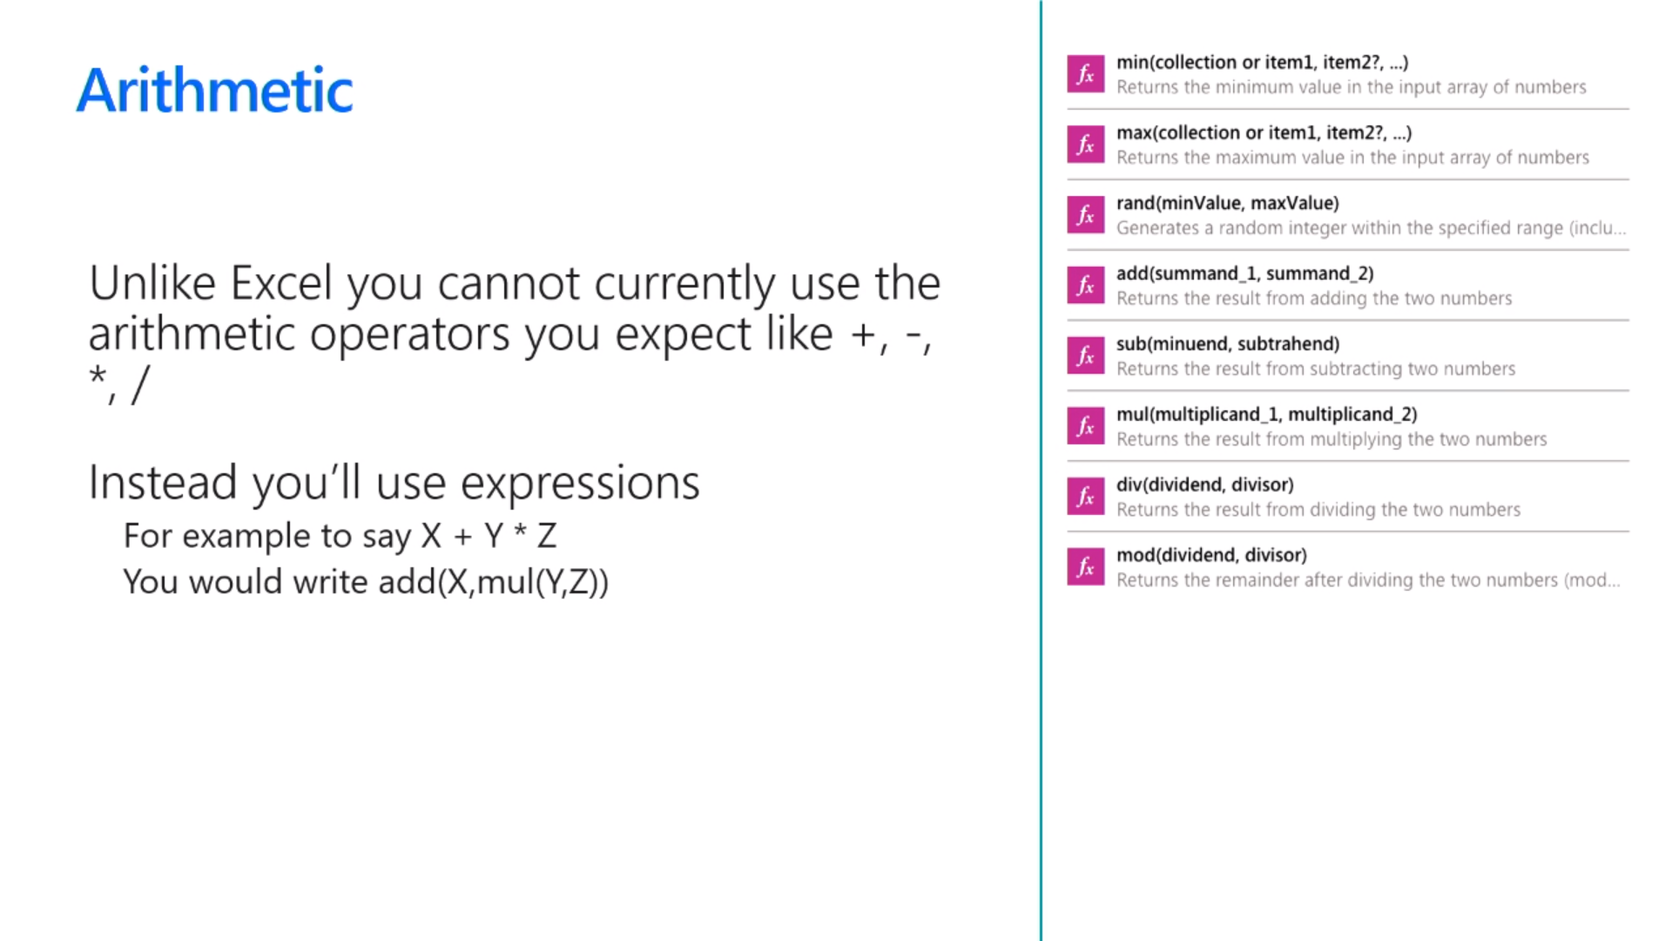
Performing Arithmetic Operations
You cannot use standard arithmetic operators
No support for familiar operators such as +, -, *, /
This does not work: 2 + 2
This works: add(2, 2)

Slide 16
Demo 2 Adding SharePoint List Items

Slide 17
Agenda
Flow Fundamentals
Writing Flow Expressions
Control of Flow
Processing Data and Preparing Content
Converting Between Types
Advanced Techniques

Slide 18
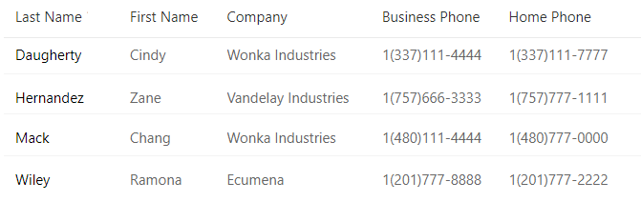
Understanding Arrays in Flow
Flow arrays are zero-based
Primitive value arrays
Object arrays
0
1
2
3
0
1
2
3

Slide 19
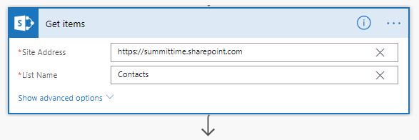
Accessing an Array using ['value']
body('Get_items')?['value']
0
1
2
3

Slide 20
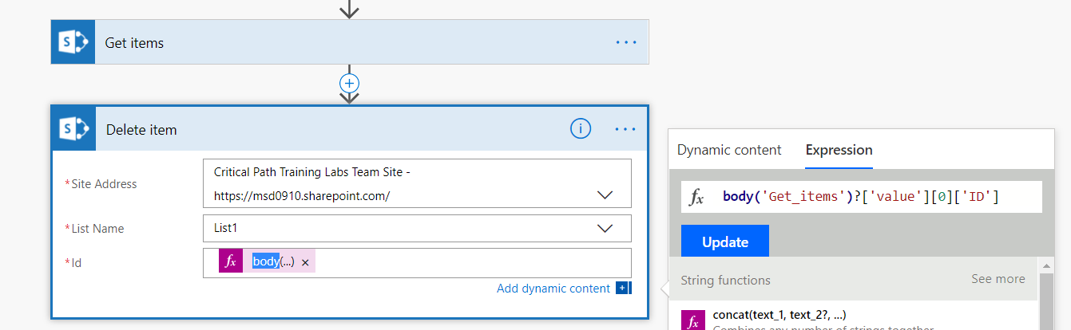
Retrieving List Items
Use first() and last() to get lead at head or tail
Individual items retrieved using zero-based array syntax
SharePoint list item array - body('Get_items')?['value']
First item field value - body('Get_items')?['value'][0]['ID']

Slide 21
Control of Flow
Condition
Provides logical structure for If Then Else
Apply to each
Enumerate through collection (e.g. list items)
Do until
Repeat until condition changes
Scope
Create an action container with a private scope
Switch
Select Case flow
Terminate
Completes a flow

Slide 22
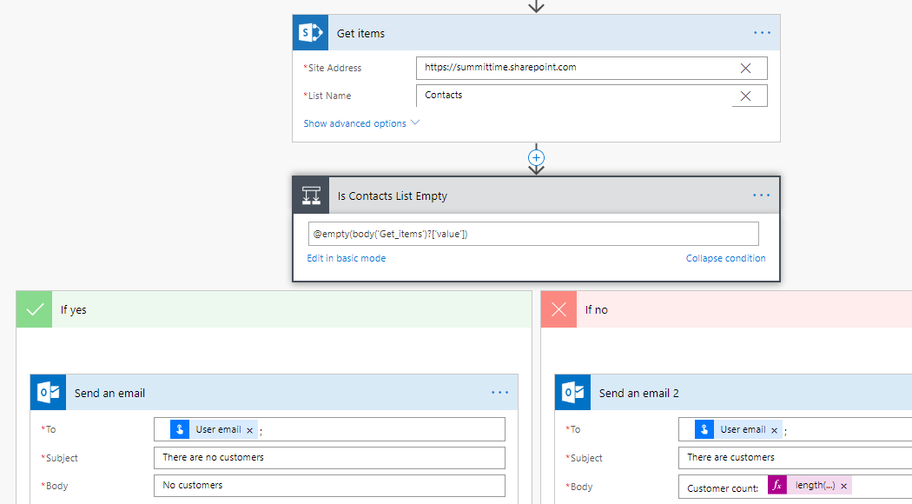
Condition Action

Slide 23
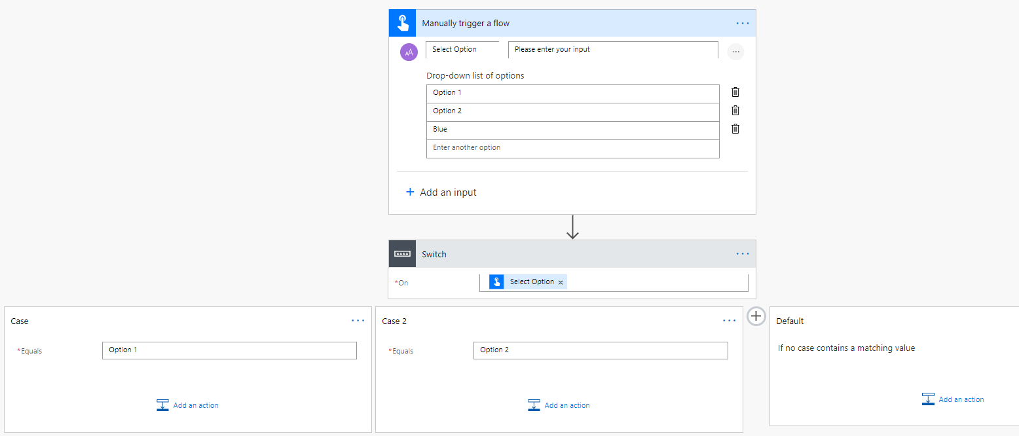
Switch Action
Switch actions provides cases
Each case represents separate execution path
Only one execution path will execute
Default case executes when no other case is matched

Slide 24
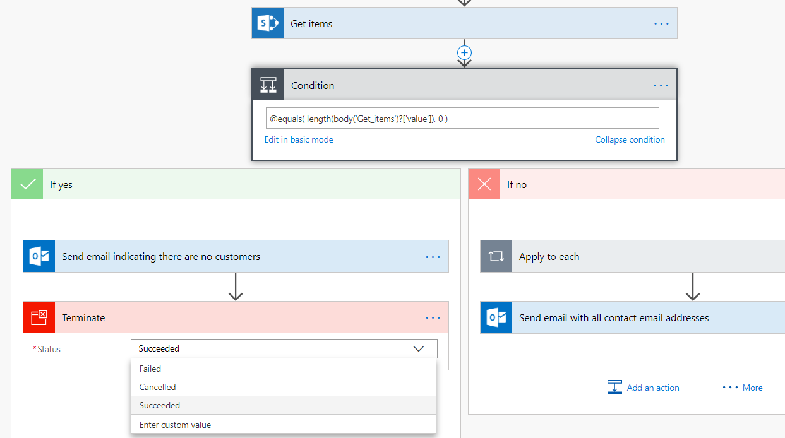
Terminate action
Used to stop a flow at any point
Terminate status can be set to Succeeded, Cancelled, Failed

Slide 25
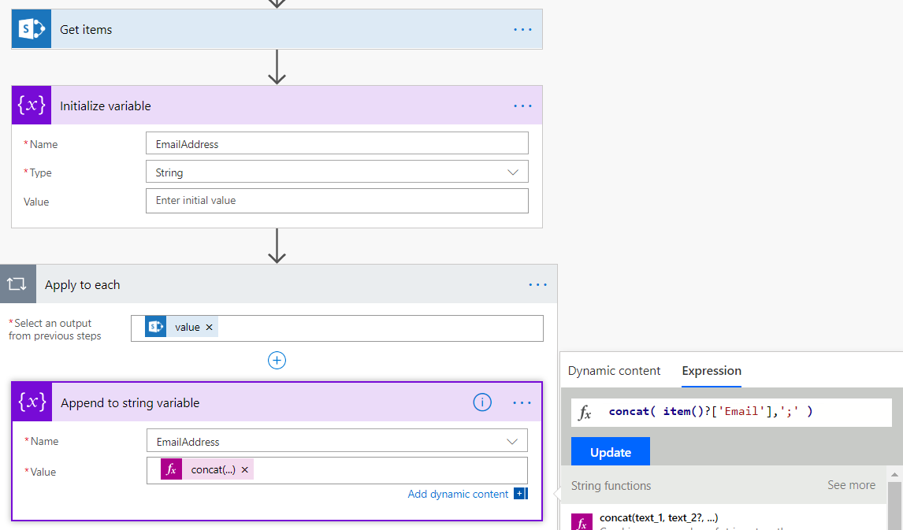
Tracking State using Variables
Variables used to track state during flow lifetime
Initialize Variable used to create variable with Type and Value
Other variable actions uses to update variable values
By default, variable stored within flow until end of flow lifetime
Variables can be initialized inside Scope action to reduce lifetime

Slide 26
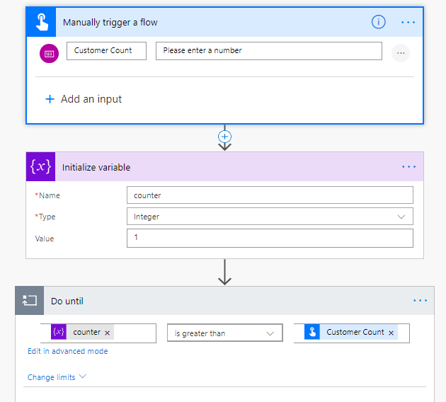
Do Until Action with Counter Variable

Slide 27
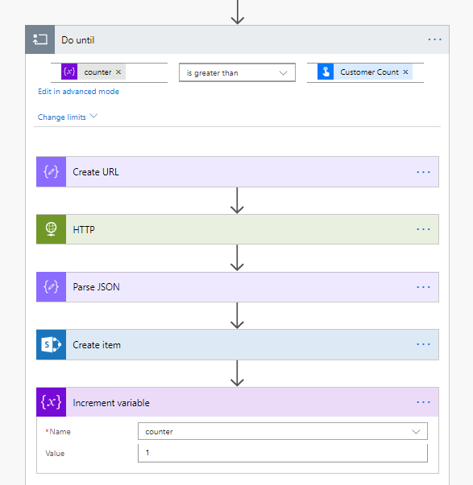
Executing Operations inside Do Until Loop

Slide 28
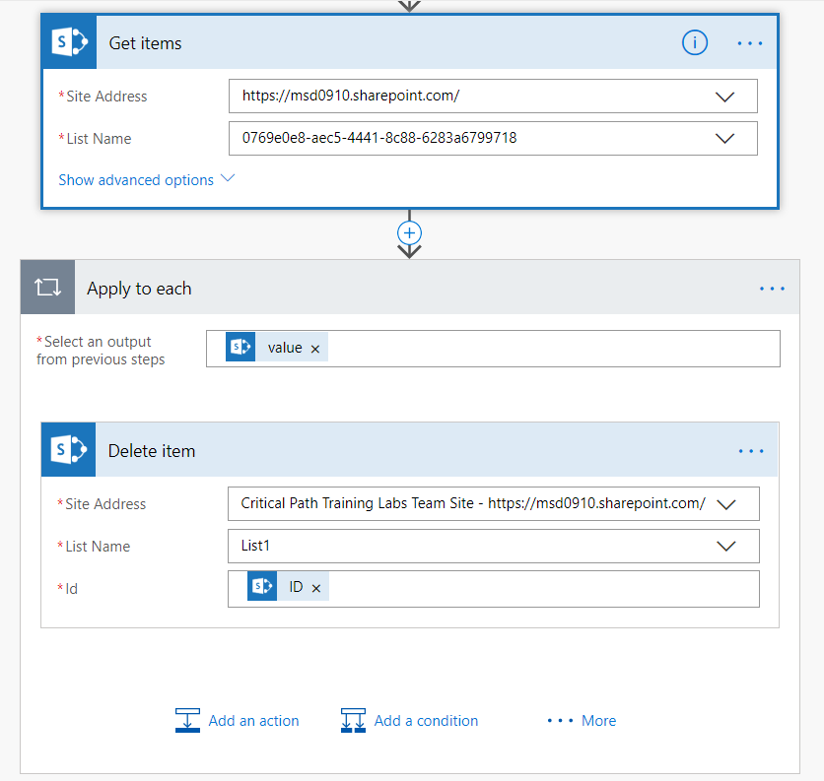
Using Apply to Each
Automatically added when list is used from output
Destination step enumerates over list items

Slide 29
Demo 3 Apply to Each and Do Until

Slide 30
Agenda
Flow Fundamentals
Writing Flow Expressions
Control of Flow
Processing Data and Preparing Content
Converting Between Types
Advanced Techniques

Slide 31
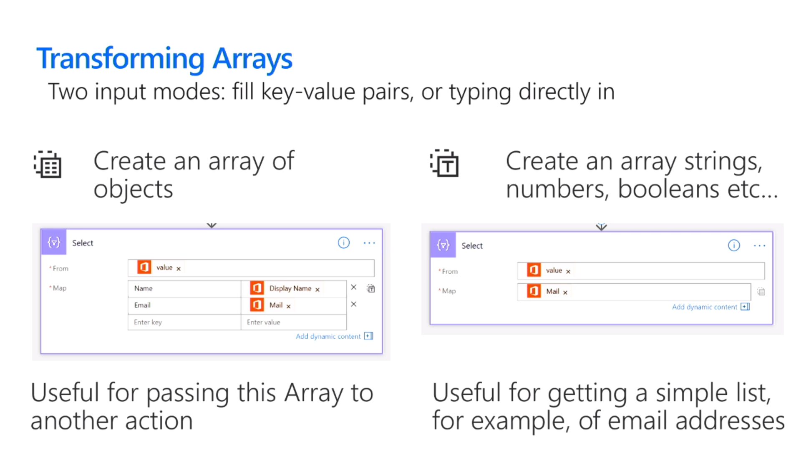
Transforming Arrays
Use Select action
Two input modes: fill key-value pairs or typing directly
Create array object objects
Useful for passing array to another action
Create a simple array of strings, numbers, Booleans, etc
Useful for creating simple list (e.g. email addresses)

Slide 32
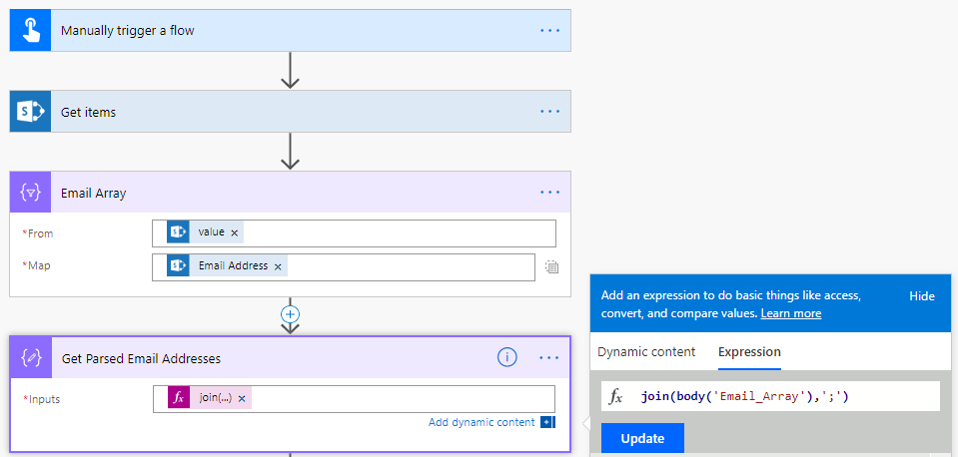
Converting an Array using Select

Slide 33
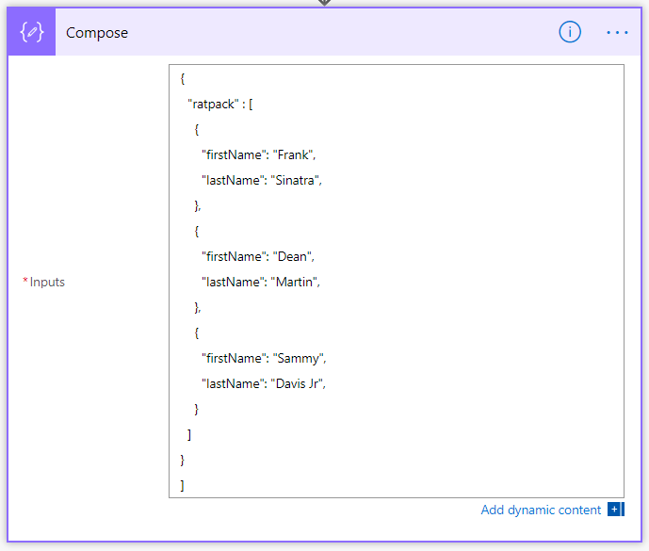
Data Operations
Used to process data and prepare content

Slide 34
Demo 4 Generating an HTML Table

Slide 35
Agenda
Flow Fundamentals
Writing Flow Expressions
Control of Flow
Processing Data and Preparing Content
Converting Between Types
Advanced Techniques

Slide 36
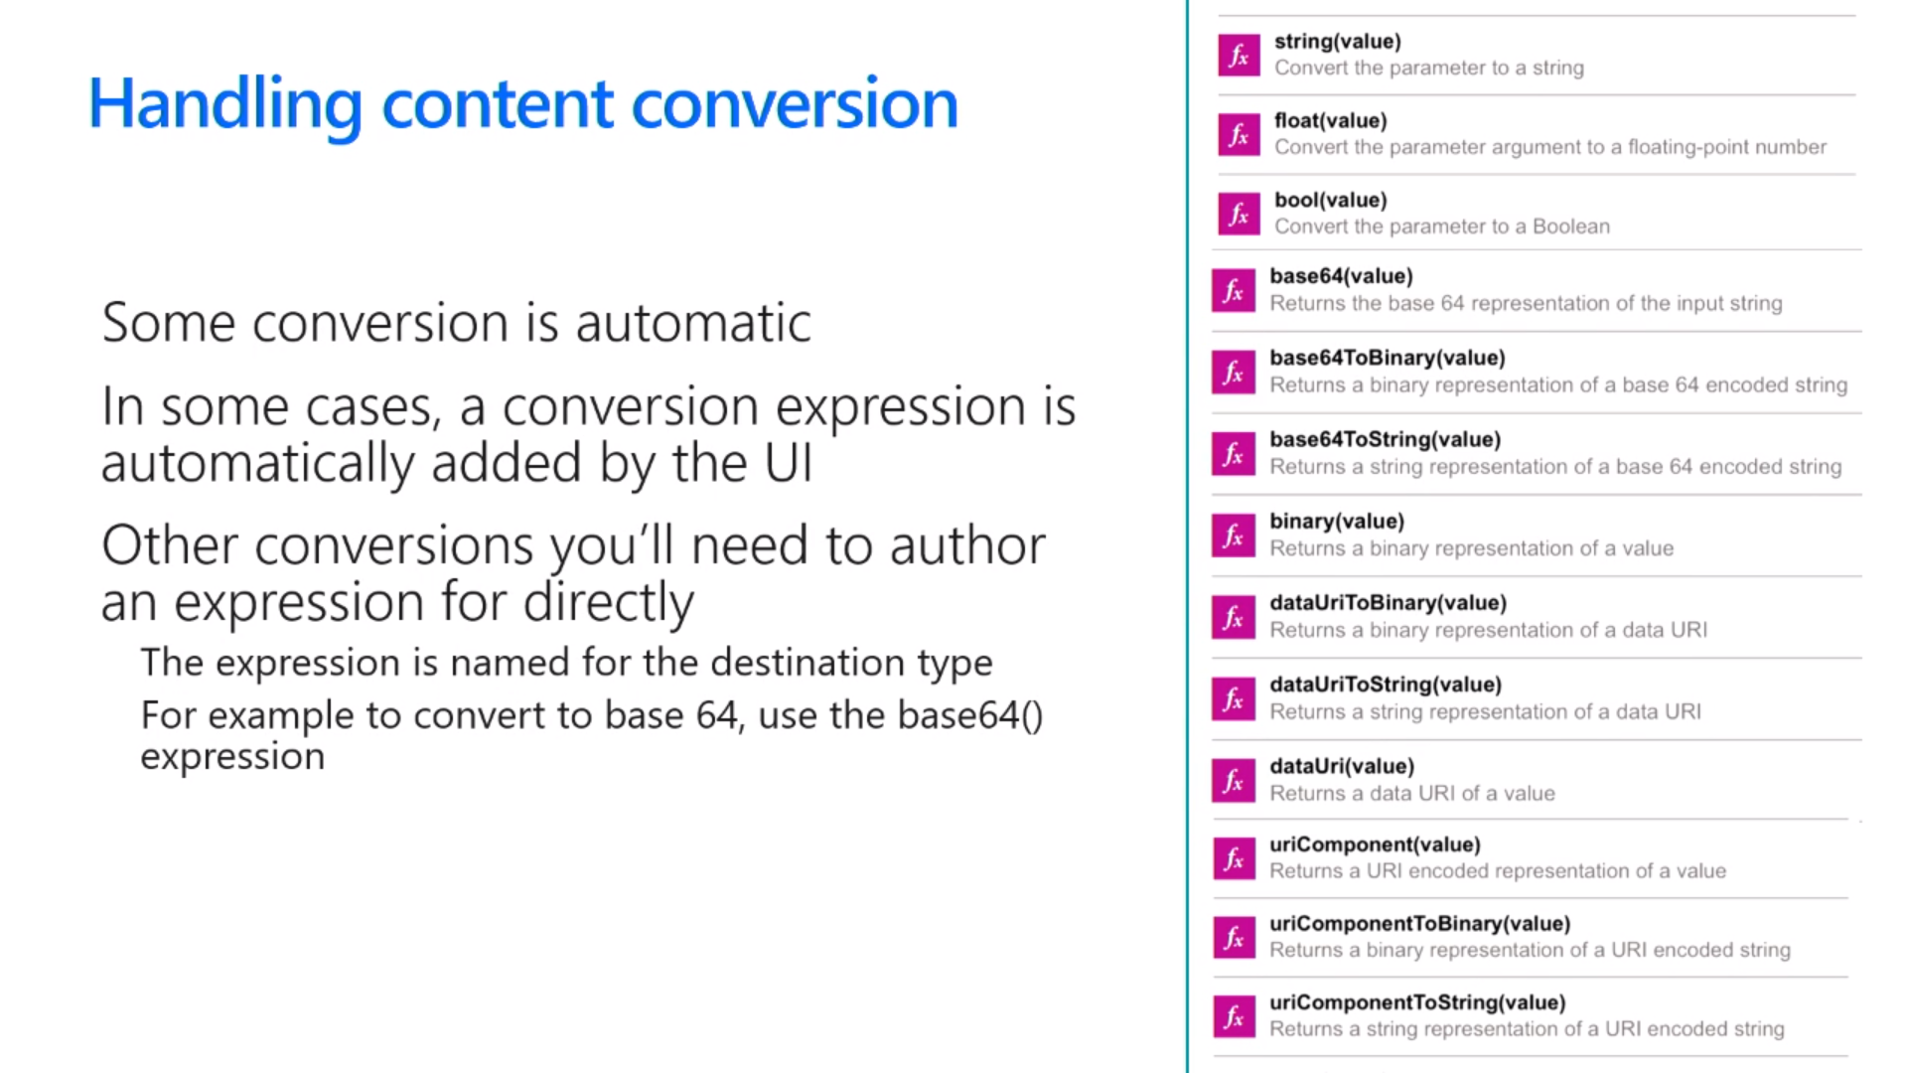
Handling Type Conversion
Some conversion is automatic
Sometimes conversions are performed for you
In other cases, you must explicitly convert between types

Slide 37
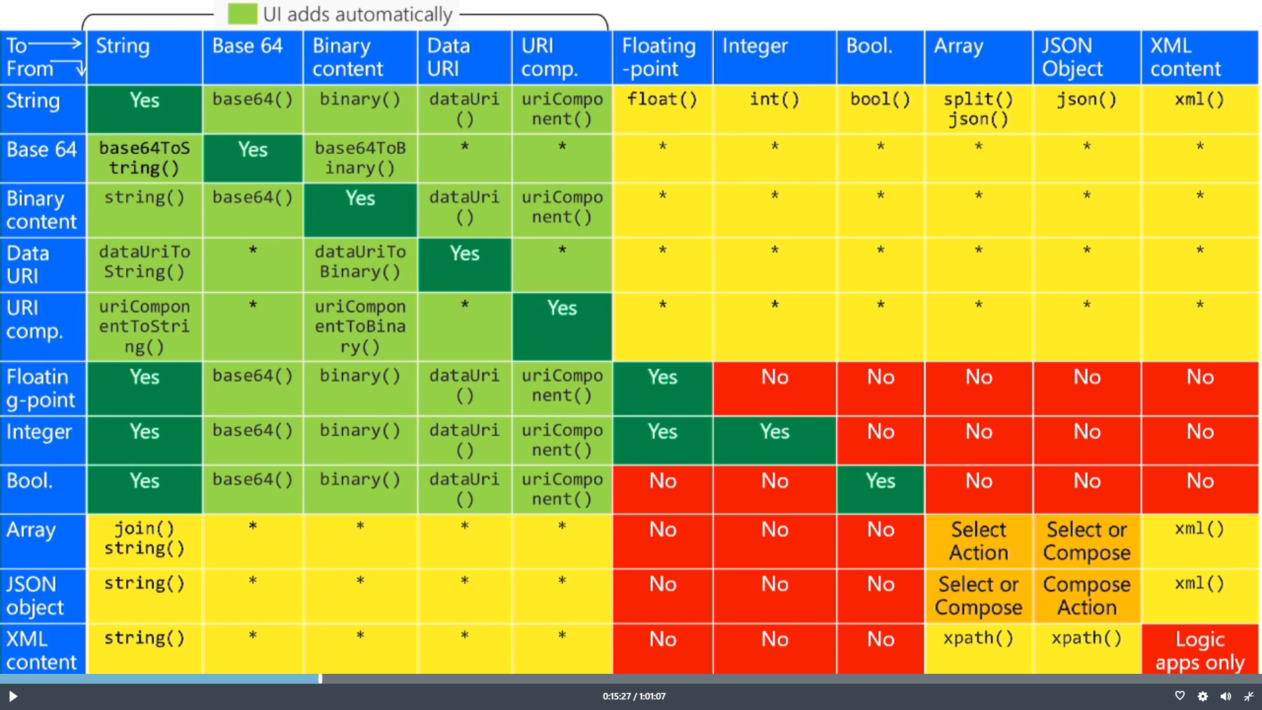
Flow Type Conversion Matrix

Slide 38
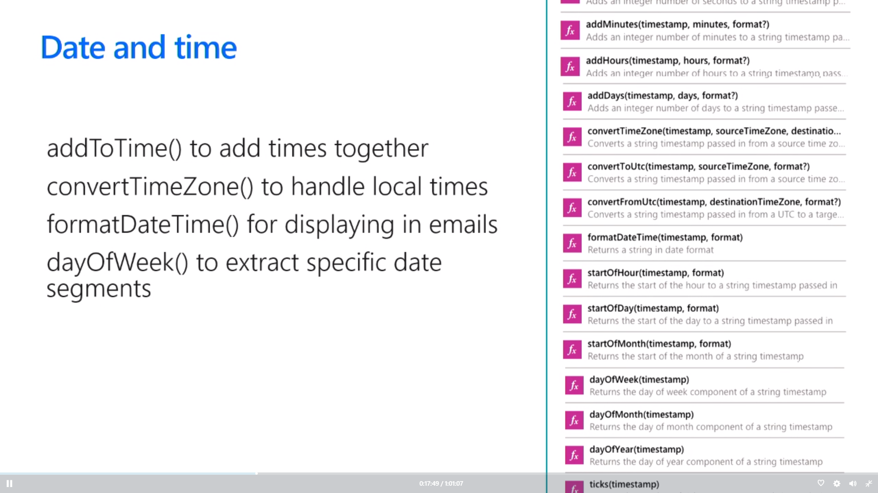
Working with Dates and Time
Get Greenwich Meantime using utcnow()
Use add*() functions to move time back/forward
convertTimeZone() used to handle local times
formatDateTime() used to format

Slide 39
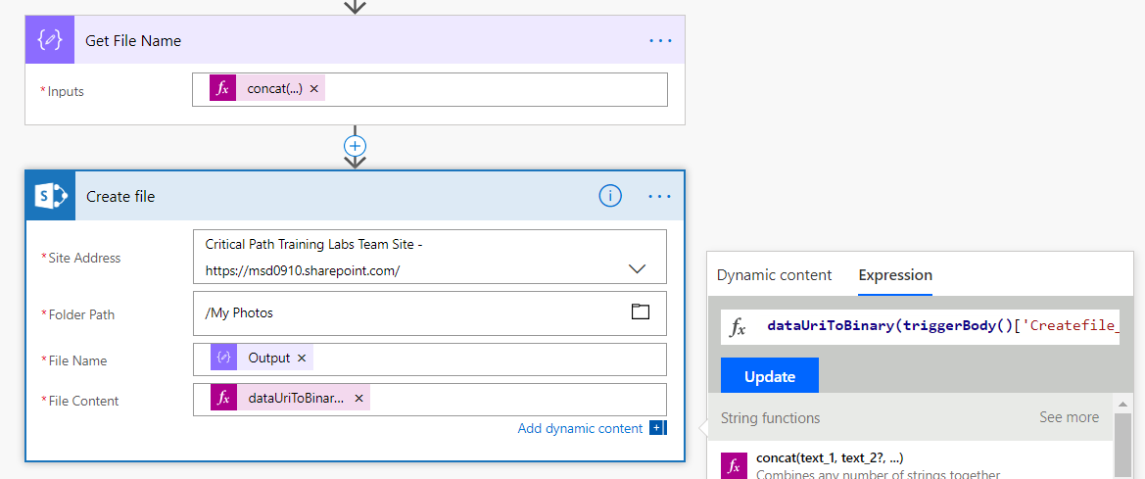
dataUriToBinary()
PowerApps photos require conversion
Allows you to upload phots to SharePoint
Accomplished using dataUriToBinary() function
dataUriToBinary(triggerBody()['Createfile_FileContent'])

Slide 40
Demo 5 Uploading Mobile Photos to SharePoint

Slide 41
Agenda
Flow Fundamentals
Writing Flow Expressions
Control of Flow
Processing Data and Preparing Content
Converting Between Types
Advanced Techniques

Slide 42
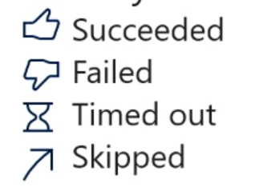
Normal action execution
Standard behavior of a flow
Action steps execute in sequential order
Flow terminates if error occurs (failure or timeout)
After flow runs, every action left in 1 of 4 possible states

Slide 43
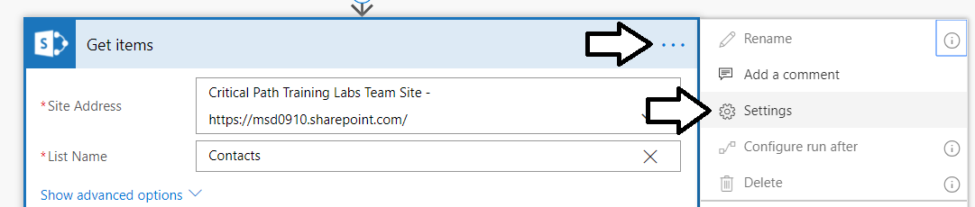
Action Settings
Settings let you configure
Async Actions
Timeouts
Retry Policy
Sequential Behavior
And more!

Slide 44
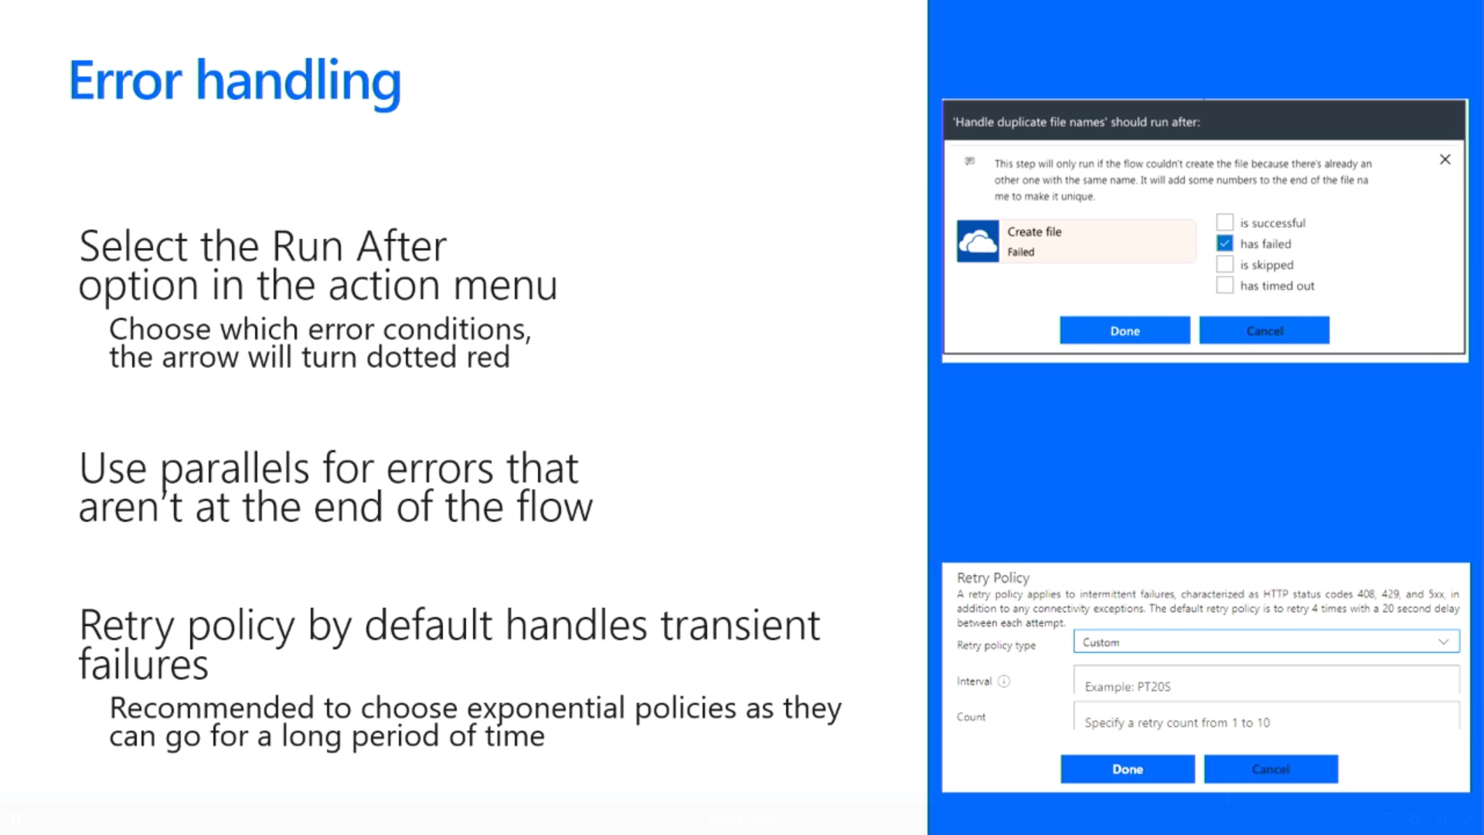
Error Handling
Select the Run after option from action menu
Choose which error conditions, the arrow will turn dotted red
Use parallels for errors that are not at end of flow
Retry policy by default handles transient failures
Recommended to select exponential as they last a long time

Slide 45
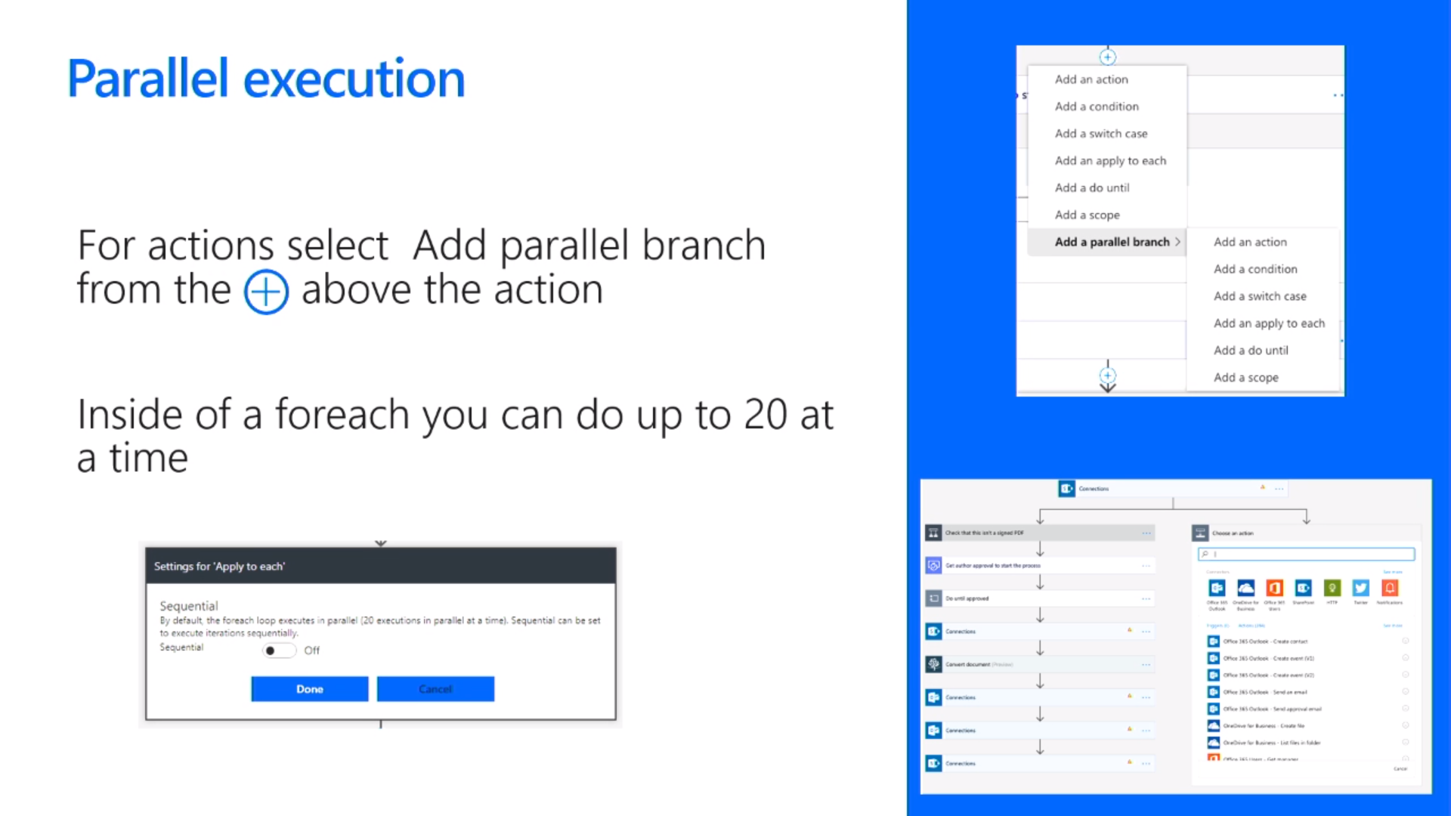
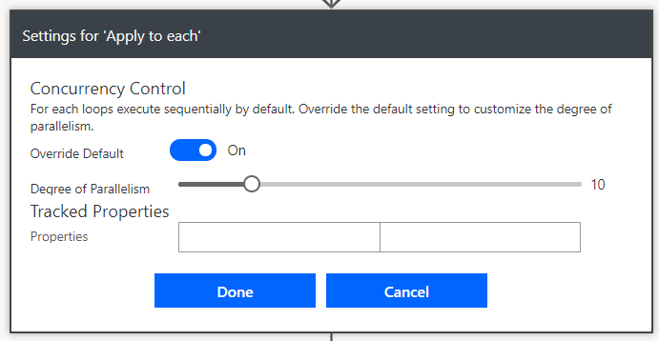
Parallel Execution
Add parallel branch from above using +
Apply to each is sequential by default
Adding parallel execute to Apply to each

Slide 46
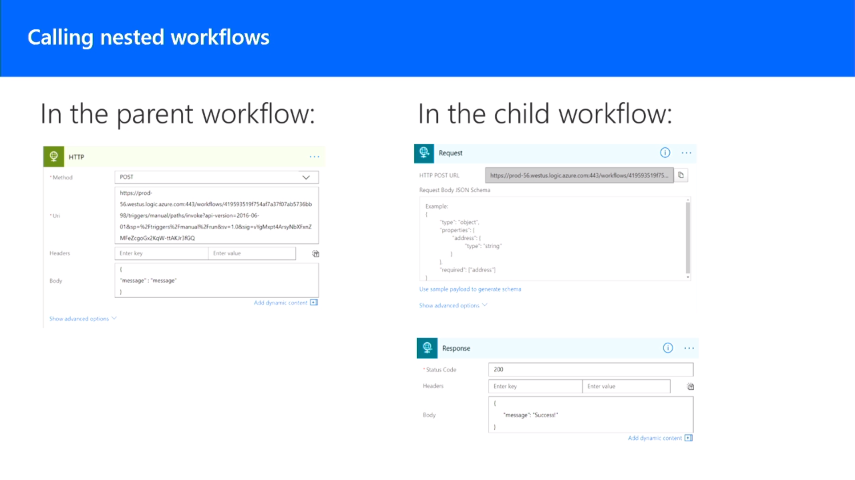
Calling Flows using the HTTP action

Slide 47
Summary
Flow Fundamentals
Writing Flow Expressions
Control of Flow
Processing Data and Preparing Content
Converting Between Types
Advanced Techniques

